Slide 1
Employee data analysis using excel
Name: keerthika
Register no:312214273
Department:Bcom(AF)
College name:ST.thomas college of arts and science

Slide 2
Project title
Employee salary using excel

Slide 3
Agenda
Problem statement
Project over view
Who are the end user
Our solution and it’s value of proportion
Date set description
Modeling
Result

Slide 4
Problem statement
problem statement is a clear and concise description of the problem or issue a team aims to address in a project. A problem statement identifies a problem's current state, desired future state, and the gaps that lie between the two.

Slide 5
Project over view
a detailed description of a project’s goals and objectives, the steps to achieve these goals, and the expected outcomes.

Slide 6
who are the end user
The term end user typically is the people your products or services are designed for. They are often your customers, defined as people

Slide 7
Our value of solution and it’s proportion
A value proposition is a short statement that communicates why buyers should choose your products or services.

Slide 8
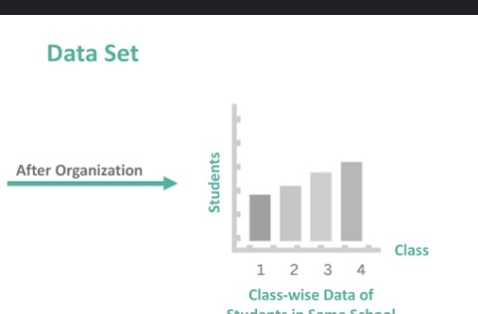
Data set analysis
A data set (or dataset) is a collection of data. In the case of tabular data, a data set corresponds to one or more database tables, where every column of a table represents a particular variable, and each row corresponds to a given record of the data set in question.

Slide 9
Modeling
Job Position | Average Salary Package (Per Project)
Parts Models | INR 25,000 to 45,000 per project
Fit Models | INR 1 lakhs to 2 lakhs per project
Promotional Models | INR 30,000 to 90,000 per project
Glamour Models | INR 60,000 to 80,000 per project

Slide 10
Employee salary in India
A salary is a form of fixed compensation given to a person for performing work during a specified period

Slide 11
Calculation of salary format
Basic Salary = Gross Salary - (All the allowances + benefits + bonuses, etc.) I.e., Basic Salary = 10,00,000 - (1,00,000 + 1,50,000 + 50,000), which is equal to Rs. 7,00,000 and hence the basic salary of Mr A is Rs. 7,00,000.

Slide 12
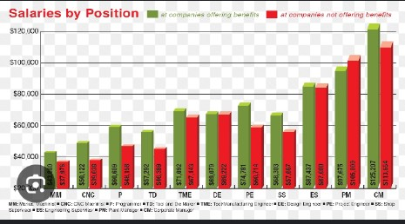

Slide 13
Conclusion
Understanding salary structures empowers organizations to manage compensation effectively

